Slide 1
Project Proposal
Database Management System

Slide 2
PROJECT NAME
PROJECT 1: TCB Family Card Holder Database
PROJECT 2: কৃষি বাতায়ন

Slide 3

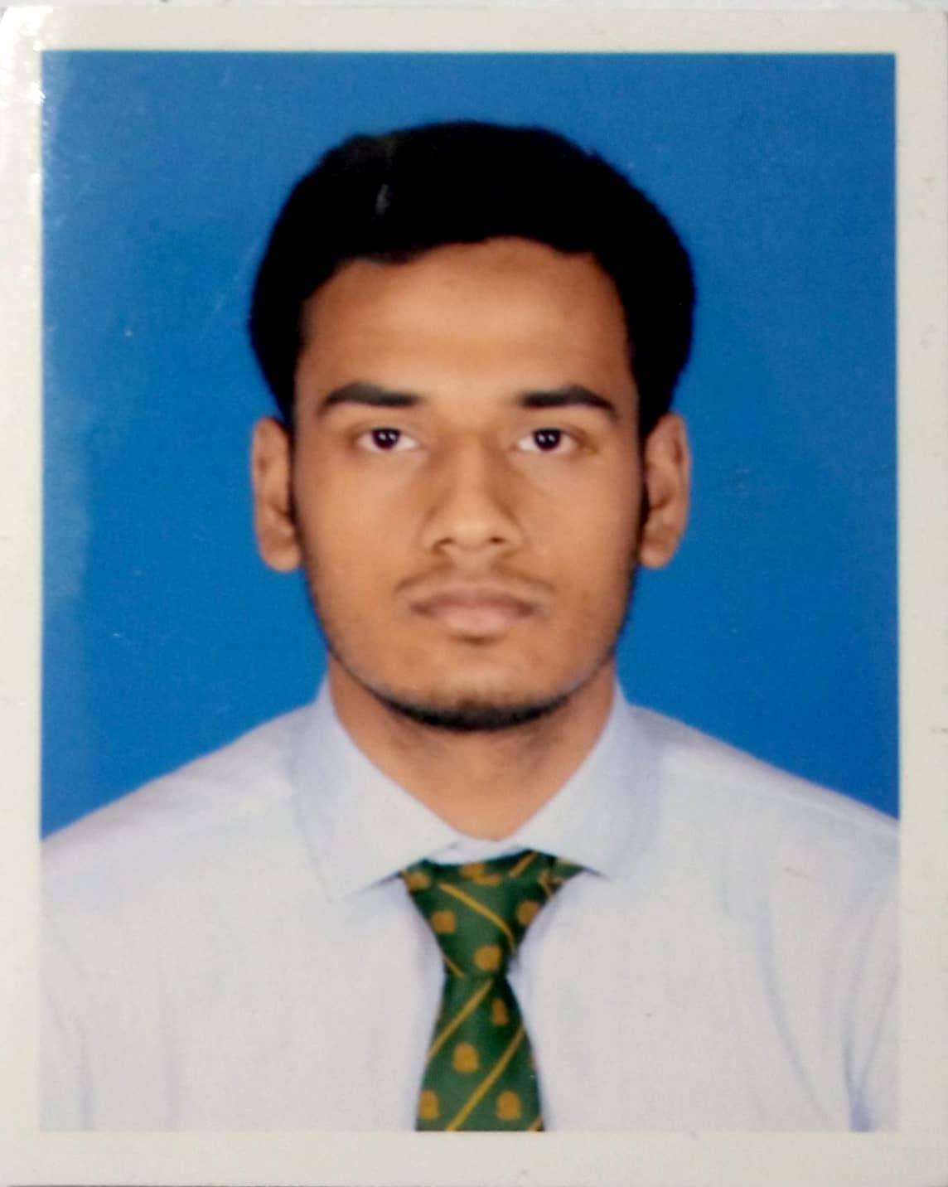



Group members
Farhan
Id: 202014014
Tausif
Id: 202014036
Rafat
Id: 202014032
Rifat
Id: 202014034
Navid
Id: 202014031

Slide 4
Project 1
TCB Goods Distribution Management

Slide 5
Objective
To provide an easier medium to mass people to get registered.
Ensuring proper distribution of TCB family cards.
Ensuring proper distribution of goods among mass people.
Providing a fully digitalized database platform to the dealers and general people.
Giving information of distribution centers and distribution dates to the users.

Slide 6
Users
Assigned government officials
TCB dealers and distributors
Mass public

Slide 7
Literature review
TCB Goods Distribution Management

Slide 8
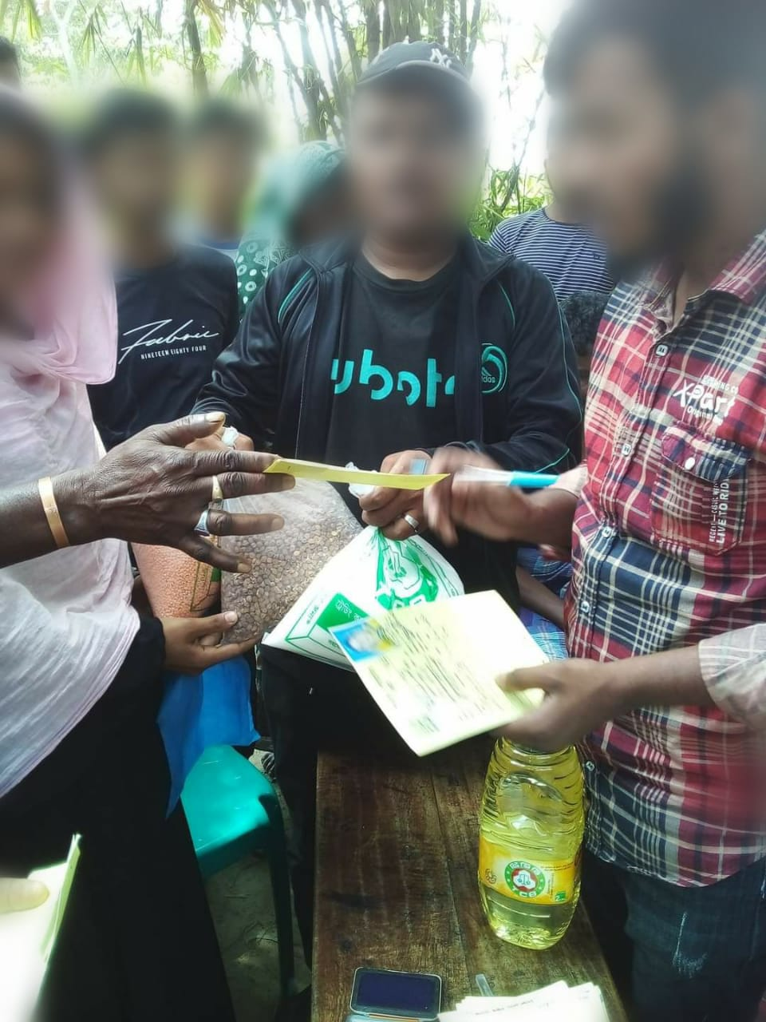
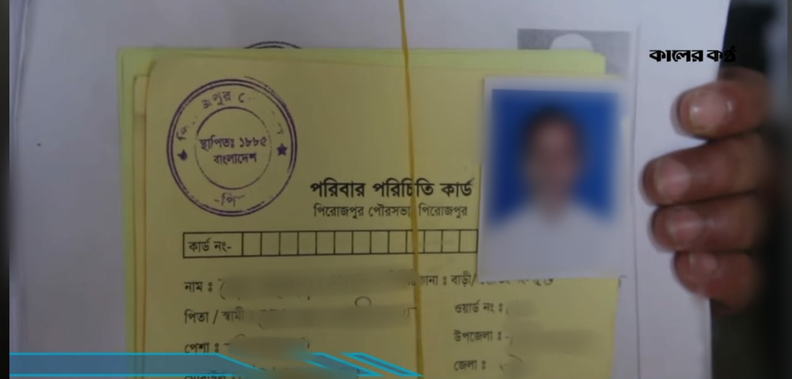
Literature Review
Current System:

Slide 9
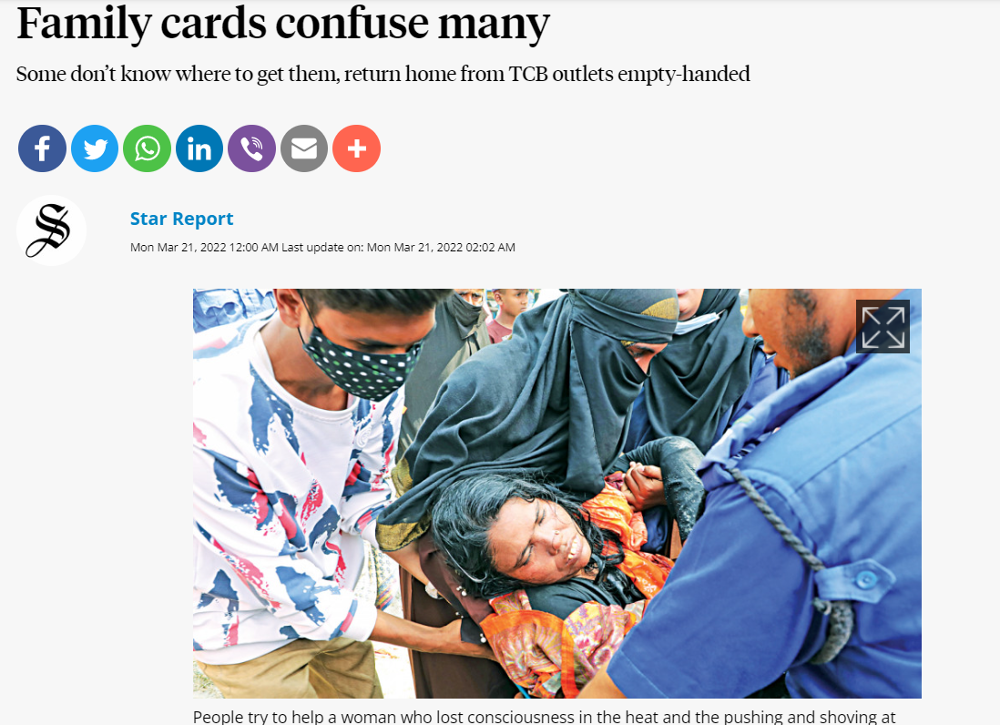
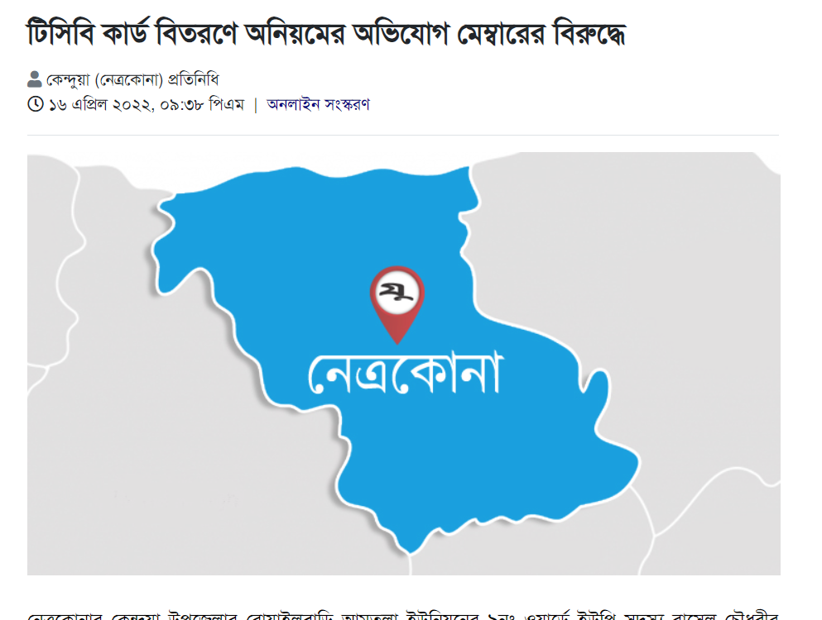
Literature Review
Source
Source

Slide 10
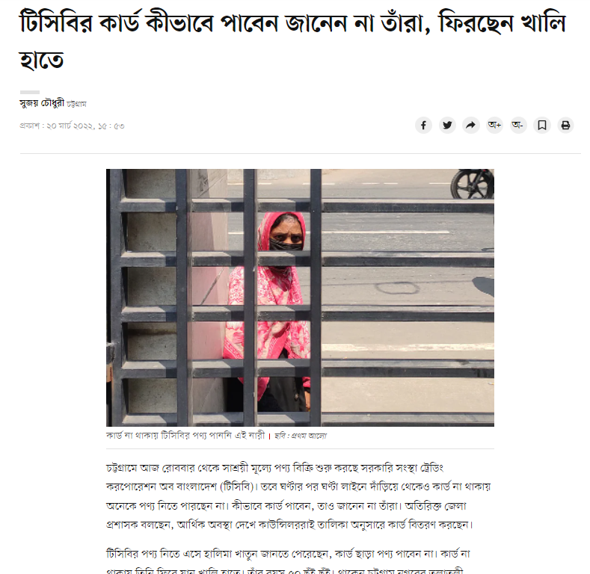
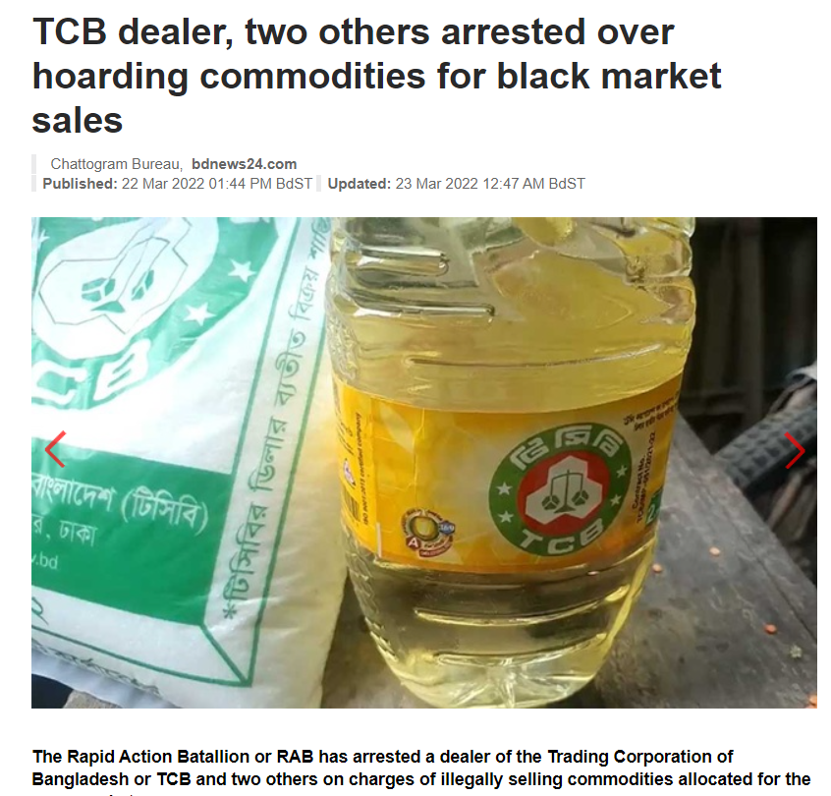
Literature Review
Source
Source

Slide 11

Field Visit
Mass People
TCB Dealers

Slide 12
Language Used
HTML, CSS, Javascript
Backend: Oracle SQL

Slide 13
Features
Separate Account for government officials, dealers and mass public.
Online family card registration.
Verification process to check if the applicant is able to register or not.
Separate issued product and distribution record for dealers.
Dealer monitoring system for government officials.

Slide 14
Project 2
কৃষি বাতায়ন

Slide 15
Objective
To build up a direct connection between government and farmers
Storing detailed info about the farmers for future planning
Giving farmers relevant information based on their location

Slide 16
Users
Assigned government officials
Farmers
Researchers

Slide 17
Literature review
কৃষি বাতায়ন

Slide 18
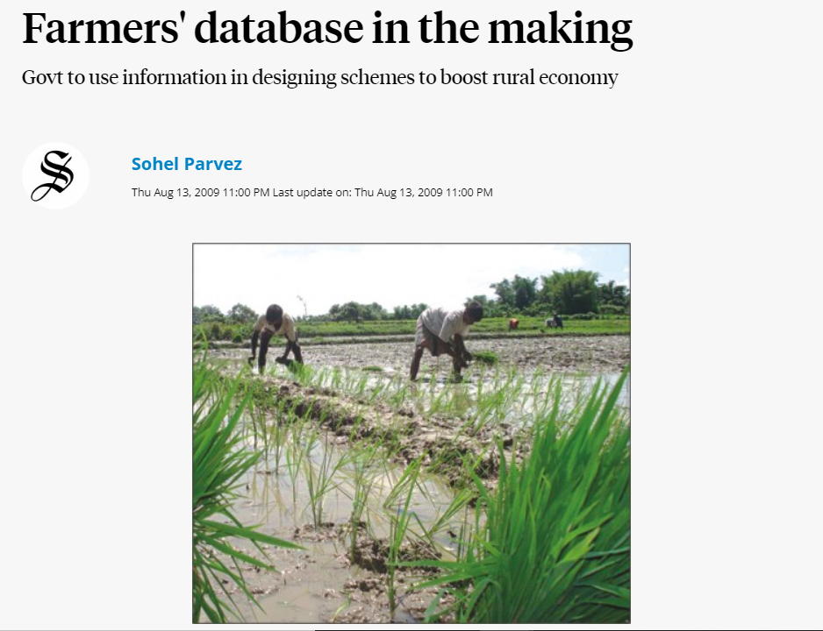
Literature Review
Source

Slide 19
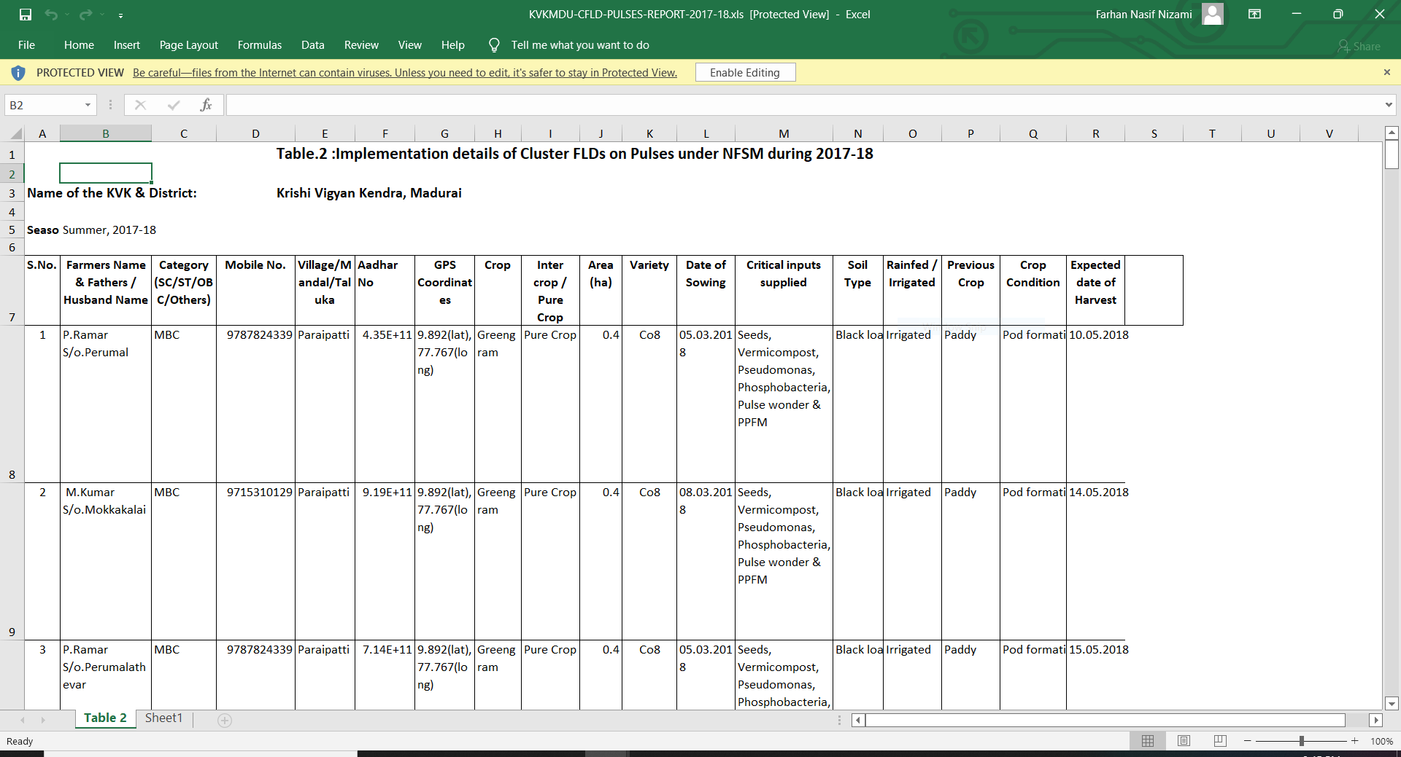
Literature review
The following institutes had made similar kind of excel sheet in small scale
Krishi Vigyan Kendras, Tamil Nadu Agricultural University
ICAR-ATARI, Meghalaya

Slide 20
Literature Review
According to the report of “The Hindu” on 06 September,2021, India has already created national database with records of 5.5 crore farmers.
Goal: Targeted service delivery with higher efficiency and in a focused & time bound manner

Slide 21
Language Using
Frontend: HTML, CSS, JavaScript
Backend: Oracle SQL

Slide 22
Features
Separate Admin and User login
Searching database based on area, crops etc.
Question answer section for farmers
Farmer’s personal information only available to the admin
Section for common crop/animal related diseases and solutions

